Slide 1
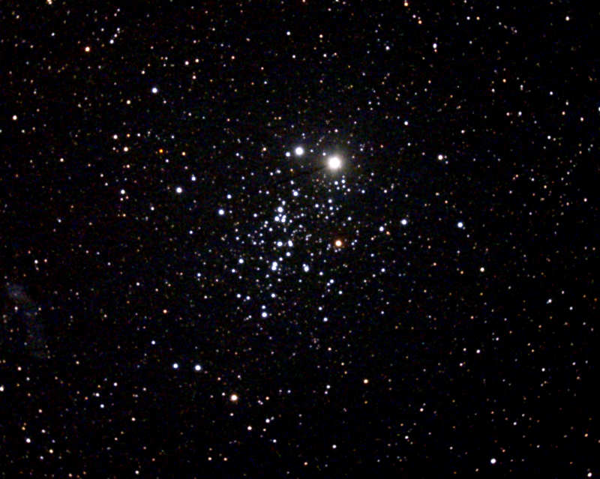
NGC 457
The E.T. Cluster

Slide 2
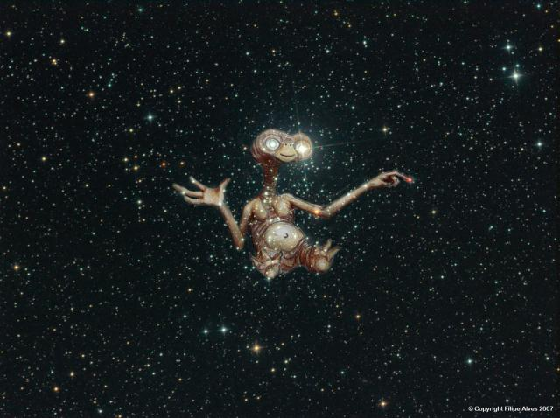
NGC 457
The E.T. Cluster

Slide 3
NGC 457
The E.T. Cluster
Visual Magnitude: +6.40
Apparent Size: 20.0 arcminutes
Distance: 7,900 light years away
Diameter: 46.1 light years across

Slide 4
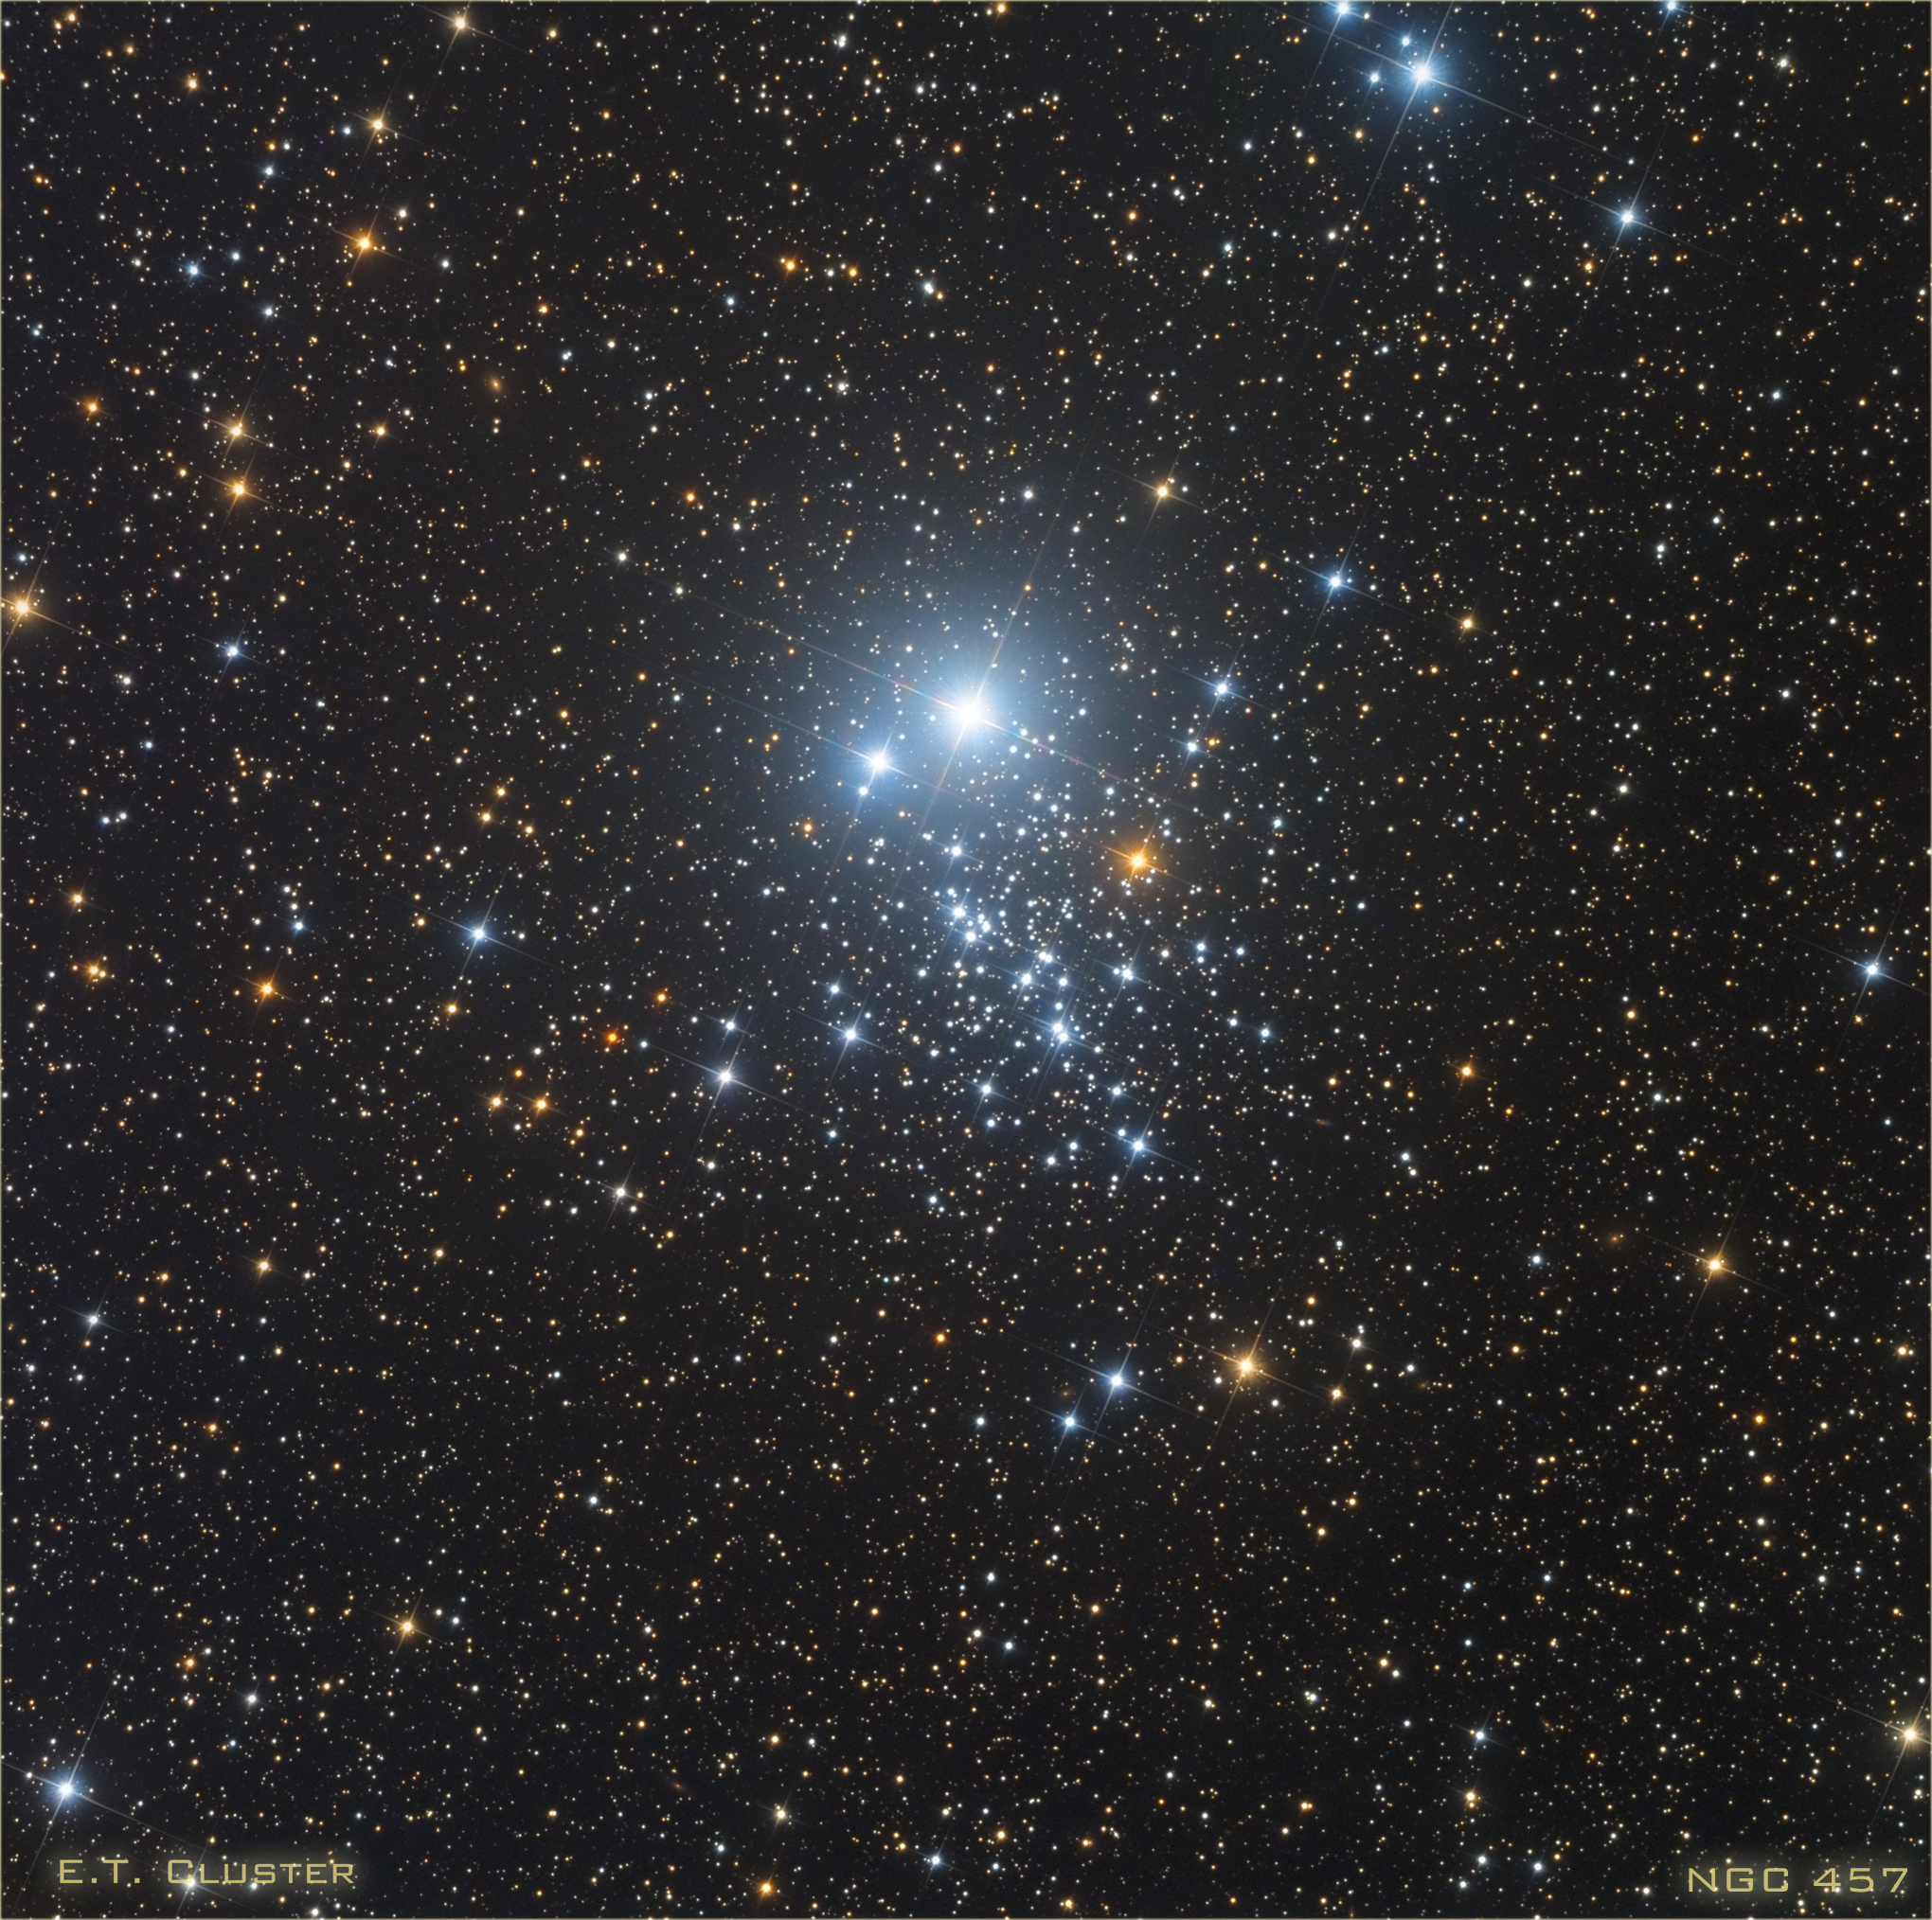
NGC 457
The E.T. Cluster
First discovered by 1787 by William Herschel.
Contains over 100 stars

Slide 5
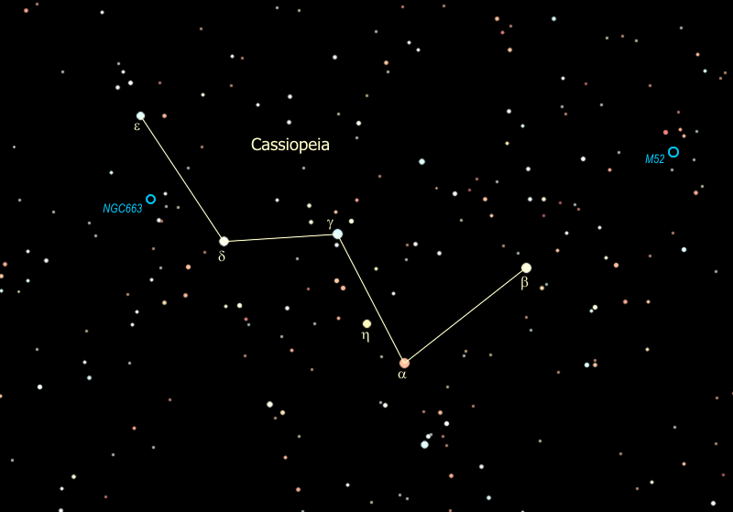
E.T. Cluster in Cassiopeia

Slide 6
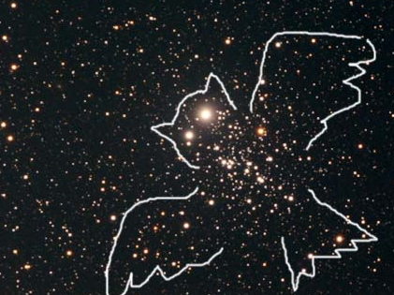
NGC 457
It is also known as the Owl Cluster.

Slide 7
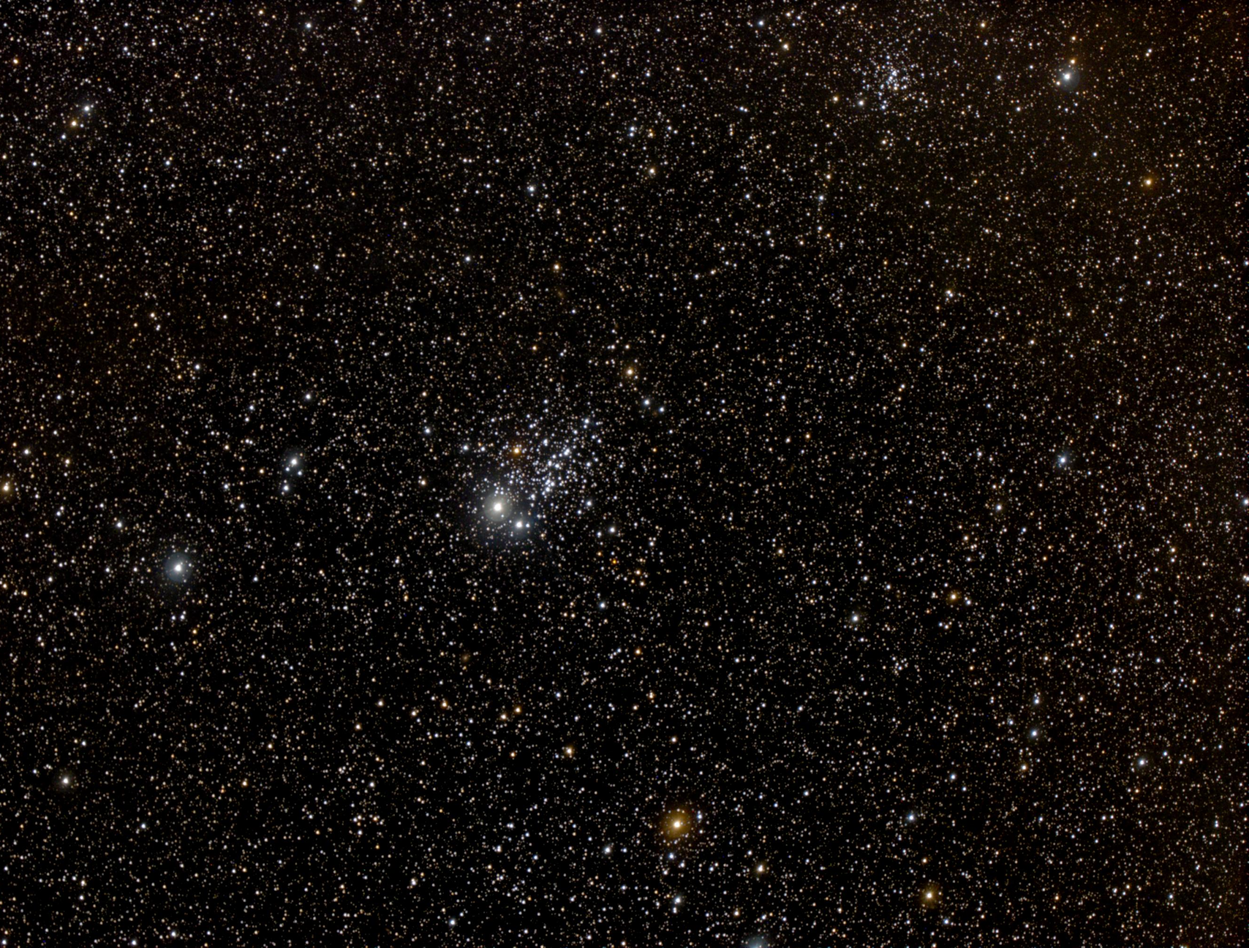
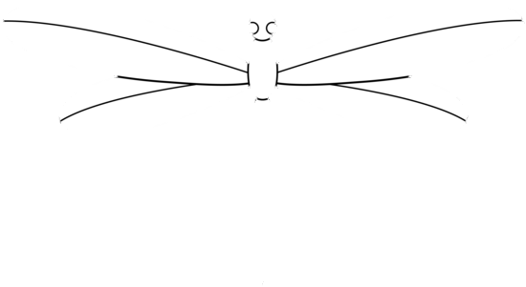
NGC 457
It is sometimes called the Dragonfly Cluster.

Slide 8
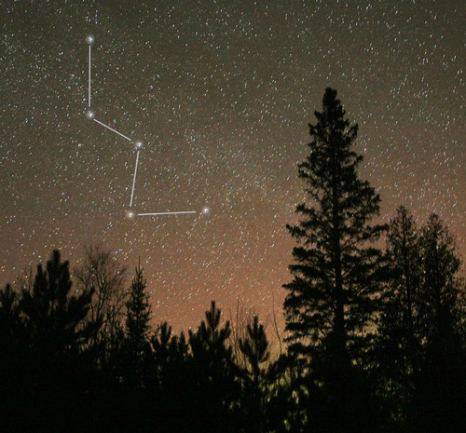
E.T. Cluster in Cassiopeia

Slide 9
NGC 457
The E.T. Cluster
This bright star is called Phi Cassiopeiae, and is not actually part of the cluster. It is simply in our line of sight with the rest of the cluster.

Slide 10
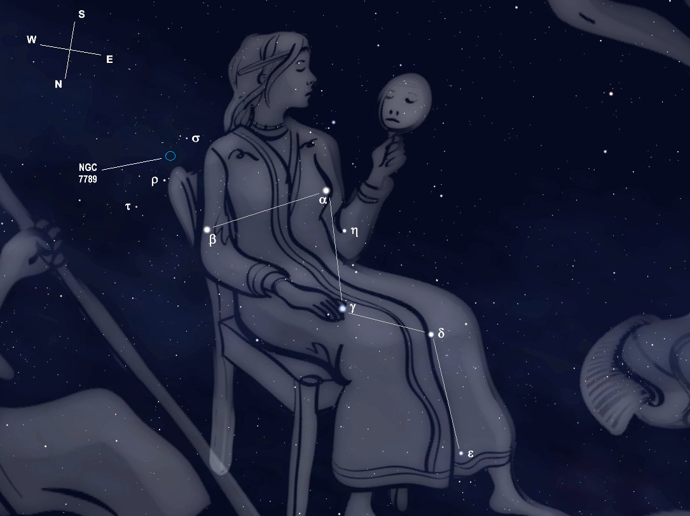
E.T. Cluster in Cassiopeia

